Slide 1
Executive Summary: Airline Safety
DSC640-T301 Data Presentation and Visualization
Joshua Greenert
1/20/2023
Notes:
Welcome to our presentation over Airline Safety regarding Important Airlines United LLC. Our presentation today will hopefully provide some insight into the improvements and adjustments that have taken place over the last 30 years for air travel in comparison to other industries.

Slide 2

Is Airline Travel Safe?
Notes:
The main question that we’re all gathered together for today. Is Airline travel Safe? It goes without saying that any activity contains its own respective amount of risk. Nevertheless, today we’ll be comparing the risk associated with driving a car — a fairly common thing that people do — with taking a flight to see the difference in the data.

Slide 3
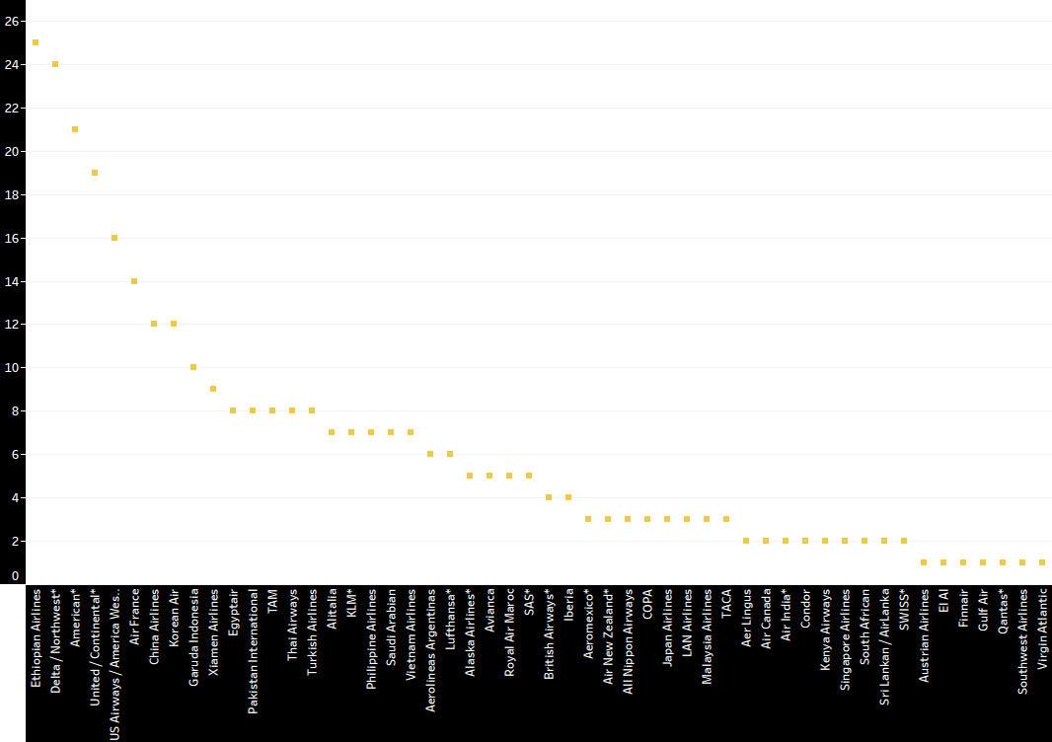
Airline Incidents 1985 - 1999
Notes:
Let’s begin by looking at incidents that took place from 1985 to 1999. I’d like to start off by pointing out that all of our graph axises will be set with black background with white text to better see the values and names of the airlines. From this chart, we can see that some airlines had more incidents than other in the 15 years shown. Moreover, we can also see that those number of incidents are less than 27 per airline, not 27 million, not 27 thousand; just 27.

Slide 4
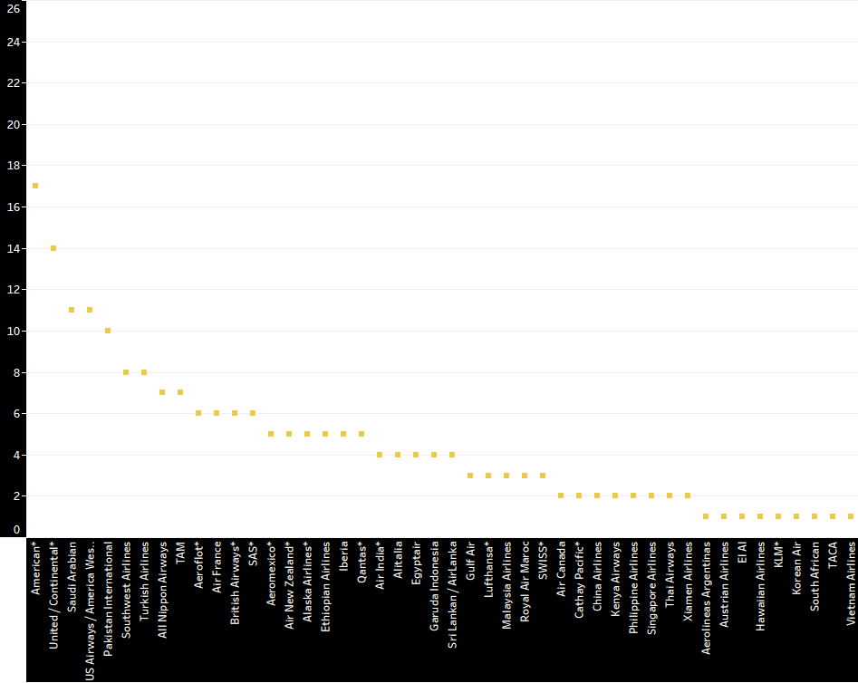
Airline Incidents 2000 - 2014
Notes:
Now, if we look at data regarding incidents with the 15 years past 1999, we see a better picture. We see substantially reduced amounts of airlines listed (since ones with 0 aren’t shown) with the majority of airlines having less than 6 incidents per 15 years.

Slide 5
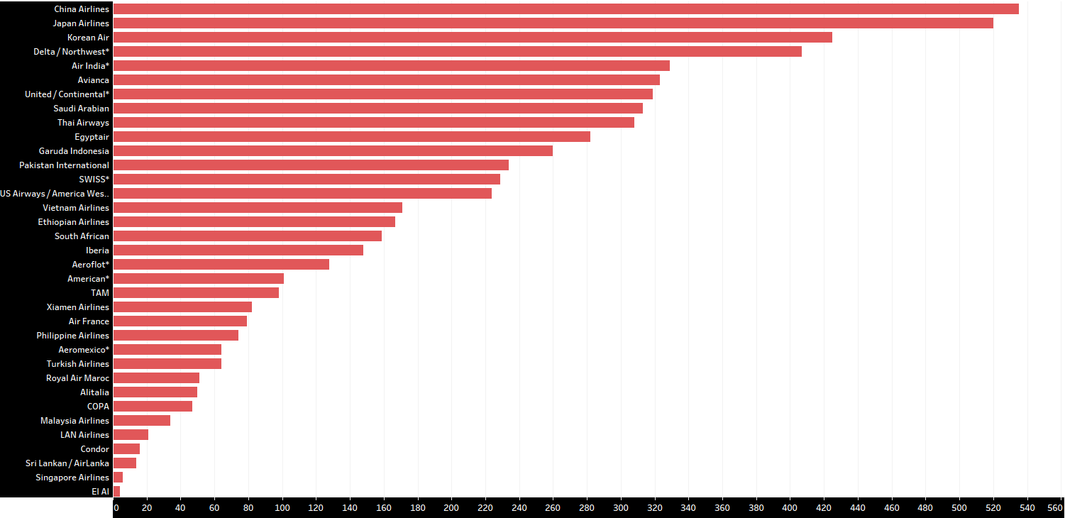
Airline Fatalities 1985 - 1999
Notes:
As we enter the scary data, I want you to keep in mind that this data covers the span of a fifteen year time period. Obviously, safety was a much more concerning subject in our past. From only the top two airlines listed, we can see a total of approximately 1000 fatalities. Collectively amongst all airlines, there were a staggering 6000 approximate fatalities. What even more spooky is that the majority of these airlines contained approximately 180 or more fatalities.

Slide 6
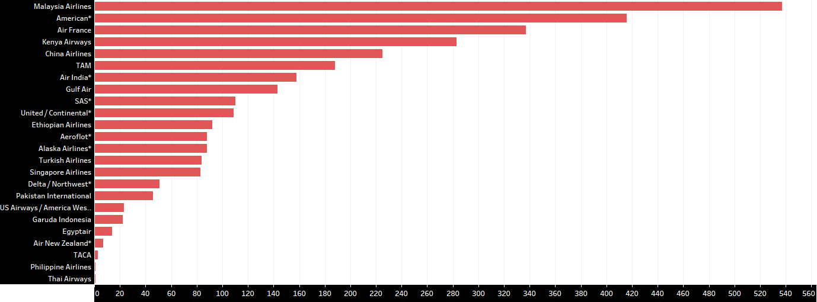
Airline Fatalities 2000 - 2014
Notes:
Similar to how the incidents dropped significantly, we see the same drop here with fatalities (especially if we exclude the malaysian airlines). The majority, of the airlines listed since airlines with less than 0 don’t show, of these airlines have a fatality rate of less than one hundred fatalities for the entire span of 15 years.

Slide 7

Is Car Travel Safer?
Notes:
Since we’ve seen some information over airline travel, let’s take a look at car data and see how it compares.

Slide 8
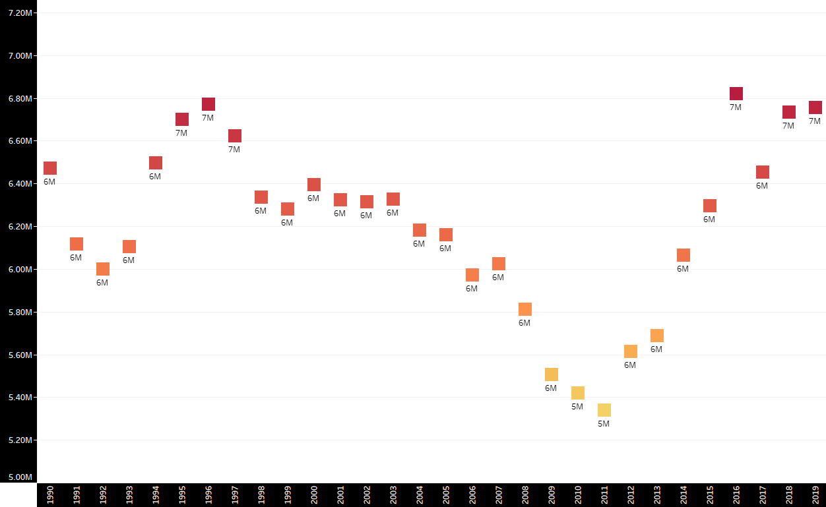
Car Crashes 1990 - 2019
Notes:
If we compare car crashes, we see a different story. We see something that should gain more attention than airline safety, first and foremost. You’ll notice that these numbers are all in the millions.from the years of 1990 to 2019. However, unlike the airline data, we see no sign of improvement from 1990 to 2019. In fact, it appears to have gotten worse every year past 2011.

Slide 9
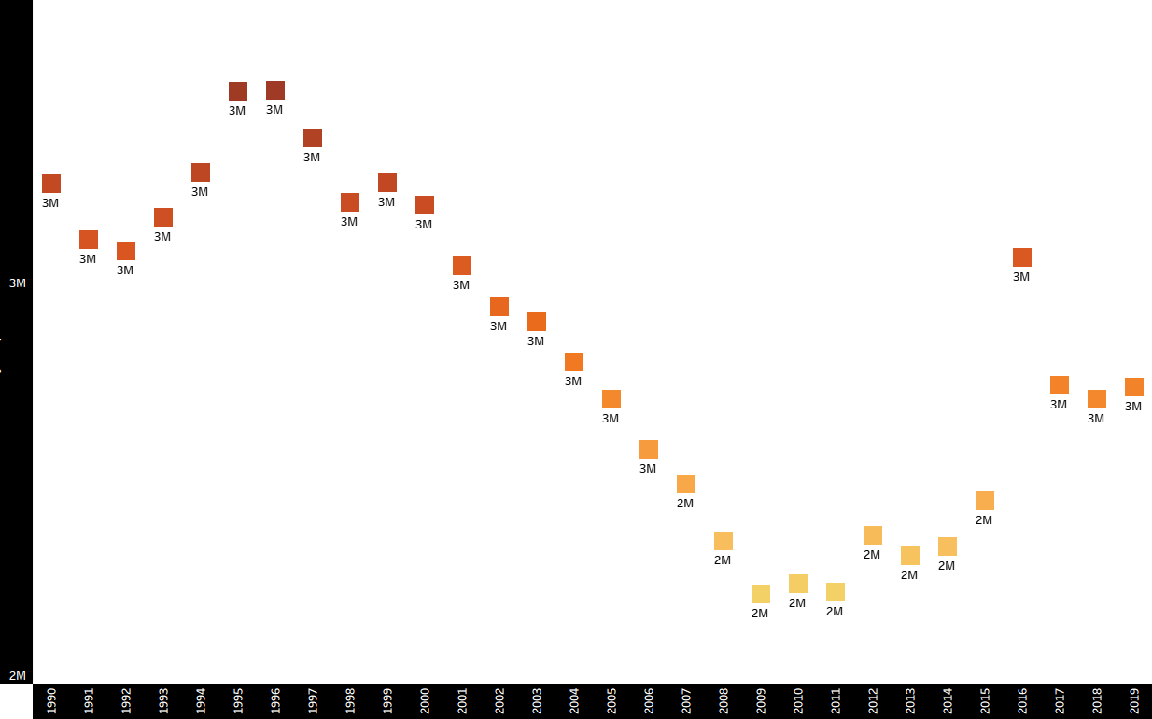
Car Injuries 1990 - 2019
Notes:
We see a similar viewpoint when reviewing car injuries. Once again, please note that these values are listed in millions with no year being less than 2 million.

Slide 10
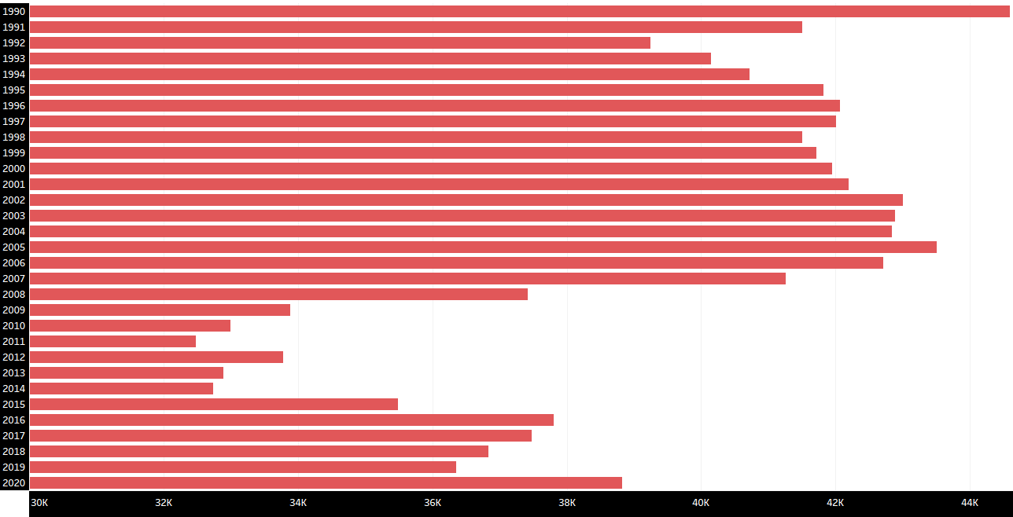
Car Fatalities 1990 - 2020
Notes:
Here’s the moment we some real spooky data. From the U.S. Bureau of Transportation, we see car fatalities (from the US only) that account for no less than 32,000 deaths per year over the past 30 years. Also unlike the airline data shown previously, we see no significant drop in the data. If we’re to focus on safety and the lives of others, we should sincerely take a look at the vehicle industry to understand how to better adjust in the same fashion that the airlines have taken.

Slide 11

Questions

Slide 12
External References
Motor Vehicle Safety Data | Bureau of Transportation Statistics. (n.d.). Www.bts.gov. https://www.bts.gov/content/motor-vehicle-safety-data

